Slide 1

Real-Time Sign Language Recognition & Conversion into Text Using Deep Learning
Presented by
Mithun Bhowmick
ID:1702050
Mrinmoy Modak
ID:1702060
Supervised by
Dr. Mohammad Rubaiyat Tanvir Hossain
Professor
Dept. of EEE, CUET
Department of Electrical and Electronic Engineering
Chittagong University of Engineering and Technology

Slide 2
Presentation Outline
Motivation
Background & Present State of The Problem
Literature Review
Aims & Objectives
Methodology
Results
Analysis
Conclusion

Slide 3
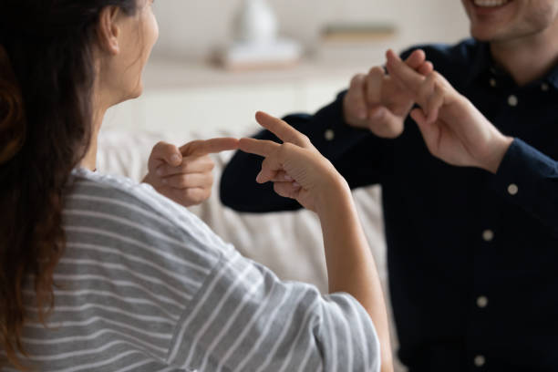
What is Sign Language?
Sign language used primarily by deaf people.
Uses different mediums such as hands, faces, or eyes rather than vocal tract or ears for communication purposes.
Fig.1. Communication by Using Sign Language [1]

Slide 4
Motivation
About 300 million people in the world are deaf, one million are dumb and 285 million people are blind.
Interaction barrier for deaf & mute people.
If there is a common interface that converts sign language to text, the hand gestures can be easily understood by other people.

Slide 5
Background & Present State of The Problem
There are many guidance and suggestions about techniques and methods for helping people with deaf and dumb problems to help them in communication [2].
Researchers have contributed and developed the field of automatic sign language recognition and the corresponding translation process [3]
Many schemes have been proposed to recognize hand and body gestures [4,5].

Slide 6
Background & Present State of The Problem(Cont..)
As images can be affected by many facts, so there are many algorithms for image processing[6]. Nowadays, Feed Forward Neural Networks (FFNN)[7], Convolutional Neural Networks (CNN), Recurrent Neural Networks (RNN) [8], etc are techniques used for image processing and sign language recognition.
In recent years, research about sign language has been used in many fields specially robotics, virtual reality, computer vision etc[9].
Our hand gesture recognition model uses LSTM, which is better than other algorithms, and there are not many studies done on this specific approach.

Slide 7
Literature Review
Title | Author(s) | Publication Year | Key Features
Sign language recognition using competitive learning in the HAVNET neural network.[10] | Vivek A. Sujan Marco A. Meggiolaro | 2000 | An optical modeless SLR system Improved recognition accuracy to 89%
A gesture recognition system using 3D data[11] | S. Malassiotis N. Aifanti M. G. Strintzis | 2002 | 3D hand feature extraction Advanced algorithm for robust segmentation
Sign language recognition and translation: A multidisciplined approach from the field of artificial intelligence.[12] | Becky Sue Parton | 2006 | Highlighted key developments in SLR Displayed the rising popularity of digital signs
American Sign Language Interpreter System for Deaf and Dumb Individuals.[13] | Sruthi Upendran Thamizharasi. A | 2014 | Features are derived from the ASL gesture photos using Principal Component Analysis (PCA).

Slide 8
Literature Review(Cont..)
Title | Author(s) | Publication Year | Key Features
Double Handed Indian Sign Language to Speech and Text[14] | Kusurnika Krori Dutta Satheesh Kumar Raju Anil Kumar Sunny Arokia Swarny | 2015 | Double-handed gesture recognition Translated to speech using COM server in MATLAB
Real-time conversion of sign language to speech and prediction of gestures using Artificial Neural Network [15] | A. Abraham V. Rohini | 2018 | A device to reduce the communication gap Increased the precision of gesture detection over time
American Sign Language Character Recognition with Capsule Networks[16] | Metin Bilgin Korhan Mutludogan | 2019 | Used a recent deep learning method named capsule network

Slide 9
Aims and Objectives
To create a real-time sign language recognition system that uses computer vision and converts the recognized sign language into text format.
To create a user-friendly app to improve typing accessibility for visually impaired and physically challenged people.

Slide 10
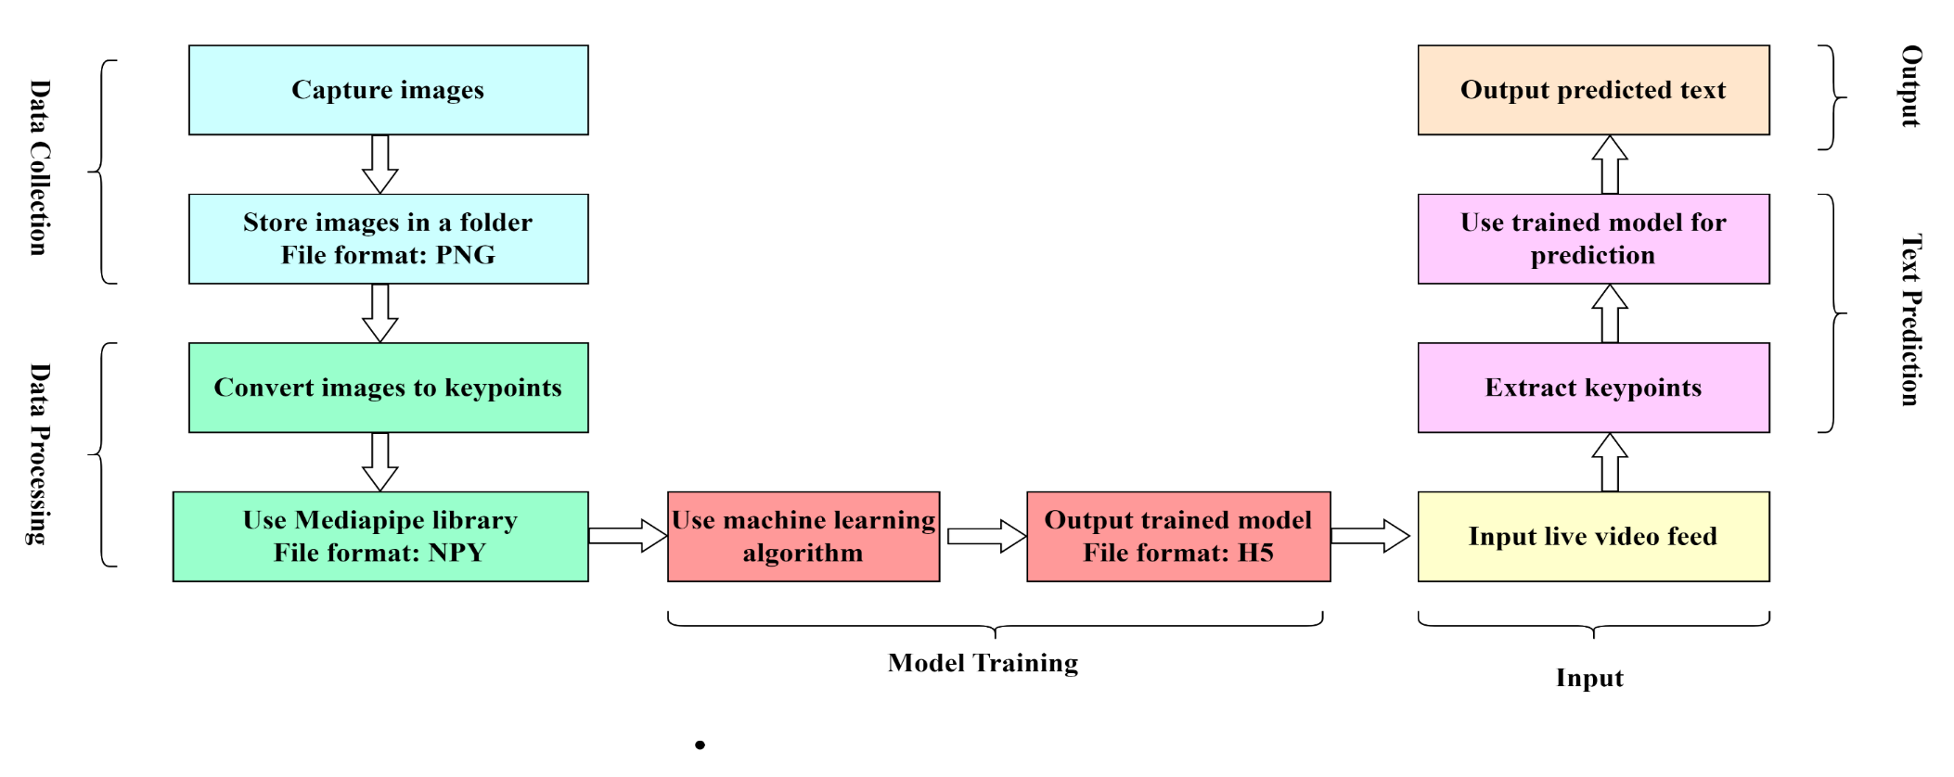
Methodology
Fig.2. Process of Real-Time Typing

Slide 11

Methodology (Cont..)
Tracking the landmarks:
The landmarks (keypoints) of the hand are found and tracked in real-time video frames using the Mediapipe library
Fig.3. Hand Landmark Detection of a image using mediapipe library[17]

Slide 12

Methodology (Cont..)
Training The Data:
LSTM (Long Short-Term Memory) architecture was used to sequentially train our machine learning model.
Fig.4. LSTM repeating module

Slide 13
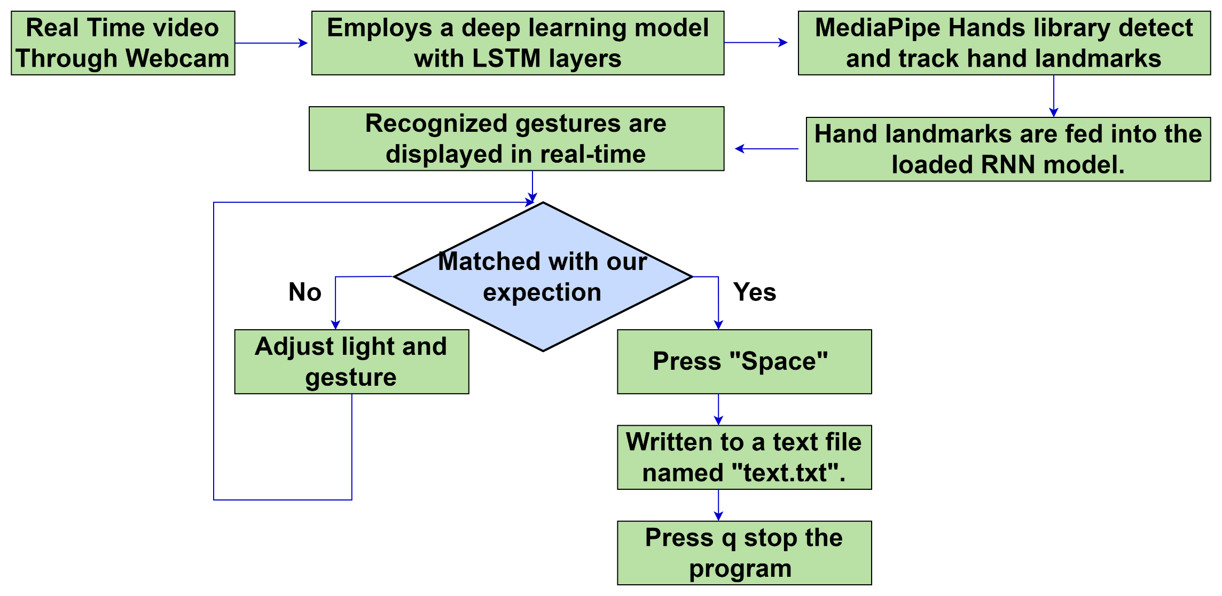
Methodology (Cont..)
Typing in a Text file:
Fig.5.System Flowchart

Slide 14
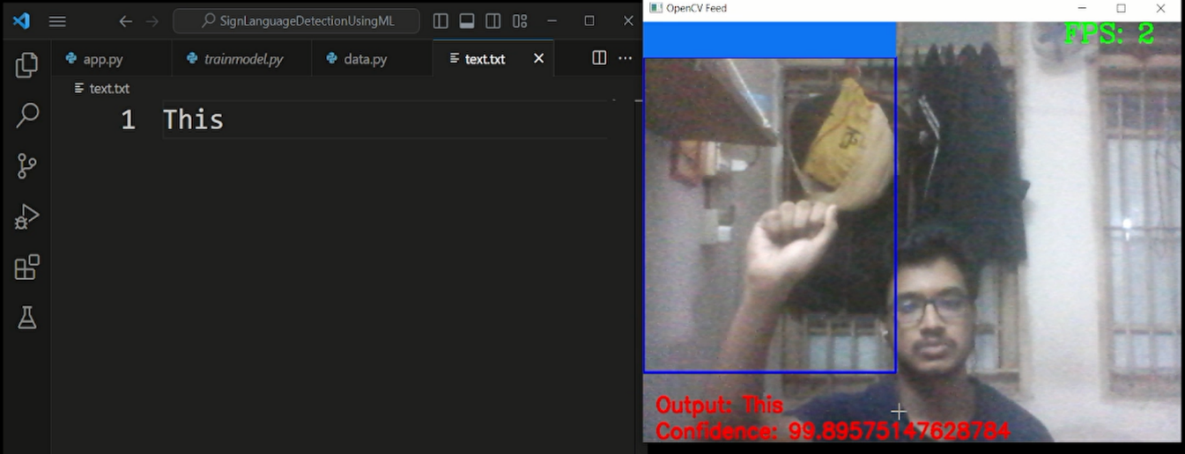
Results
The figure illustrates the successful conversion of hand gestures
into textual representation
Recognized Gesture typed in a .txt file
Fig.6. Real Time Detection and Typing the Expression

Slide 15
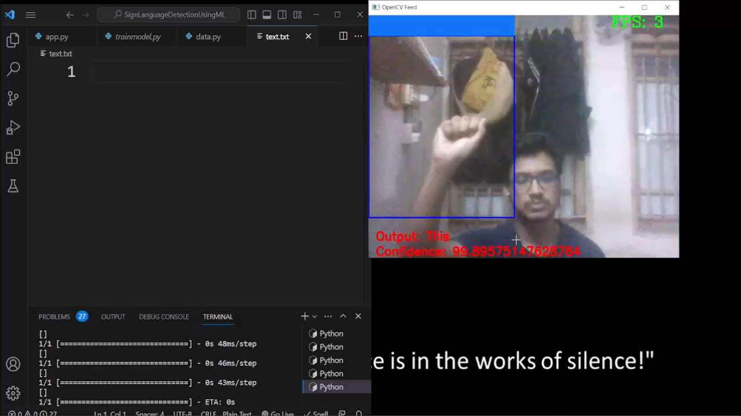
Results (Cont..)

Slide 16
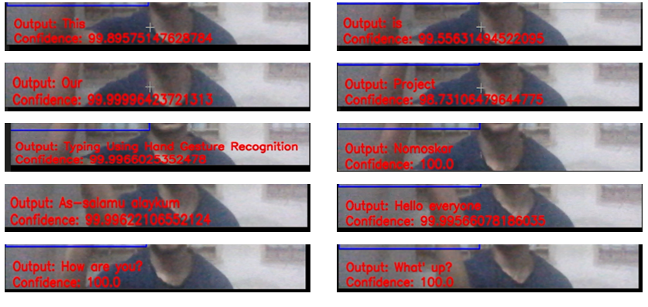
Analysis
Fig.7. Showing Confidence percentage during detection

Slide 17
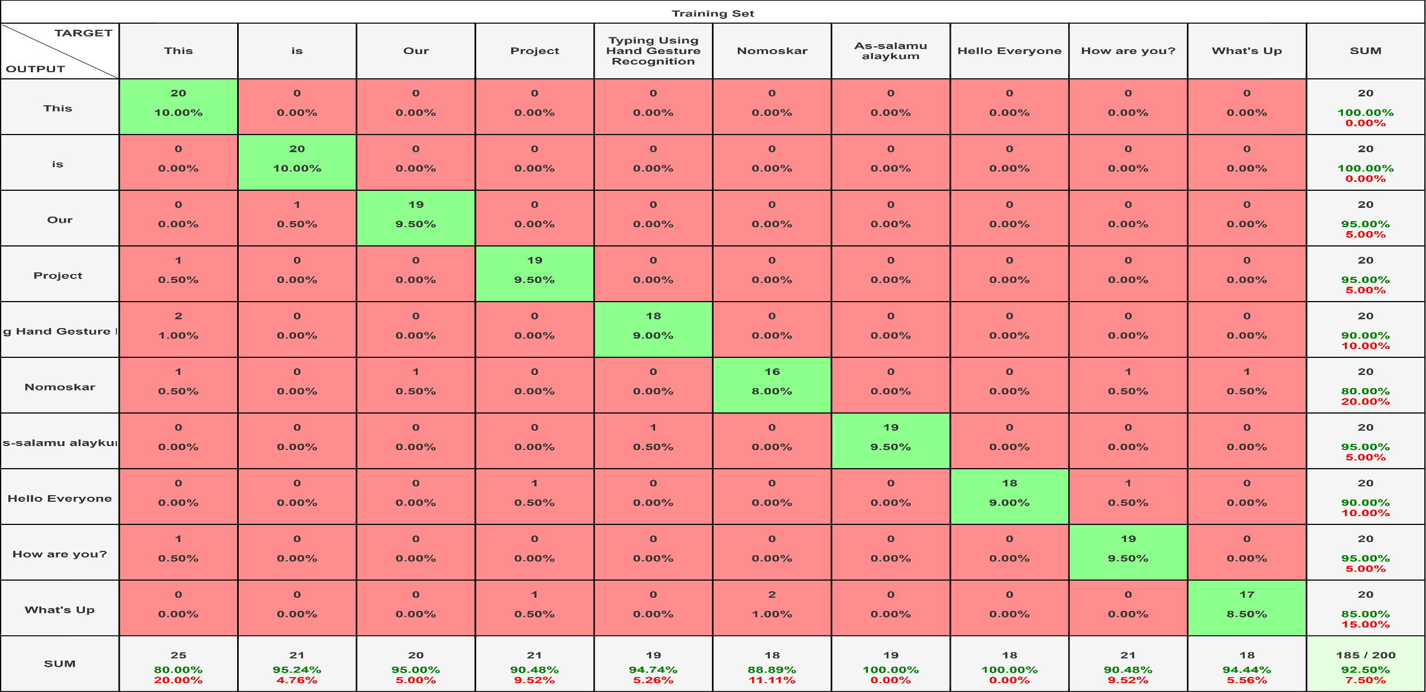
Analysis (Cont..)
Fig.8. Confusion Matrix

Slide 18
Analysis (Cont..)
The model's general confidence in its predictions is shown by the confidence percentage being between 95% and 100%.
Accuracy 92.50%.
Misclassification rate of 7.50%
As the text of the responding gesture will be typed when we press the “Space" button. So, the typing accuracy can be maintained very close to 100% by manual adjusting during recognition.

Slide 19
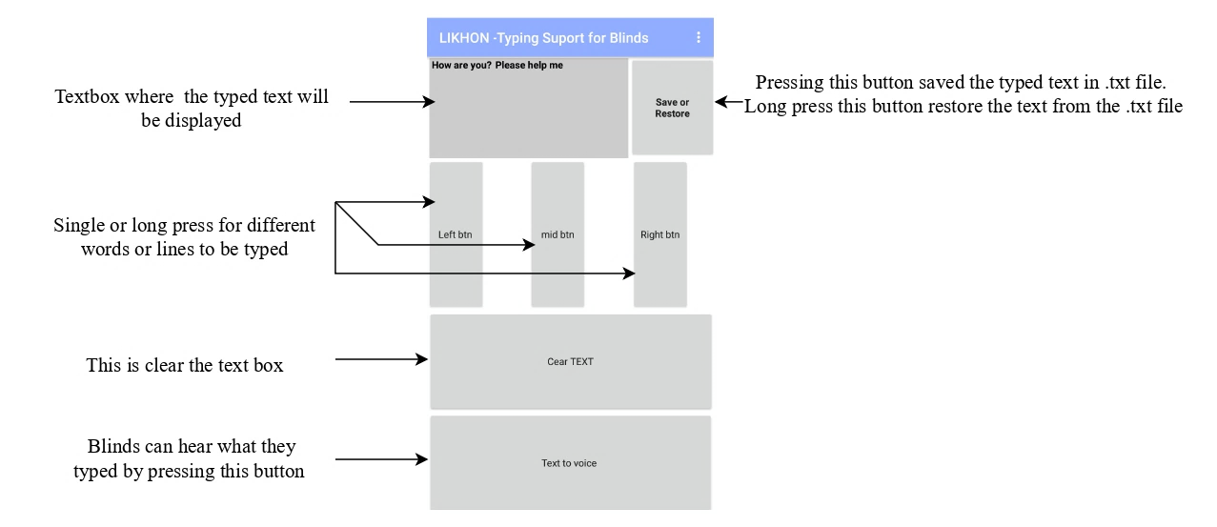
App Interface Design
Easy Typing Interface for blinds:

Slide 20
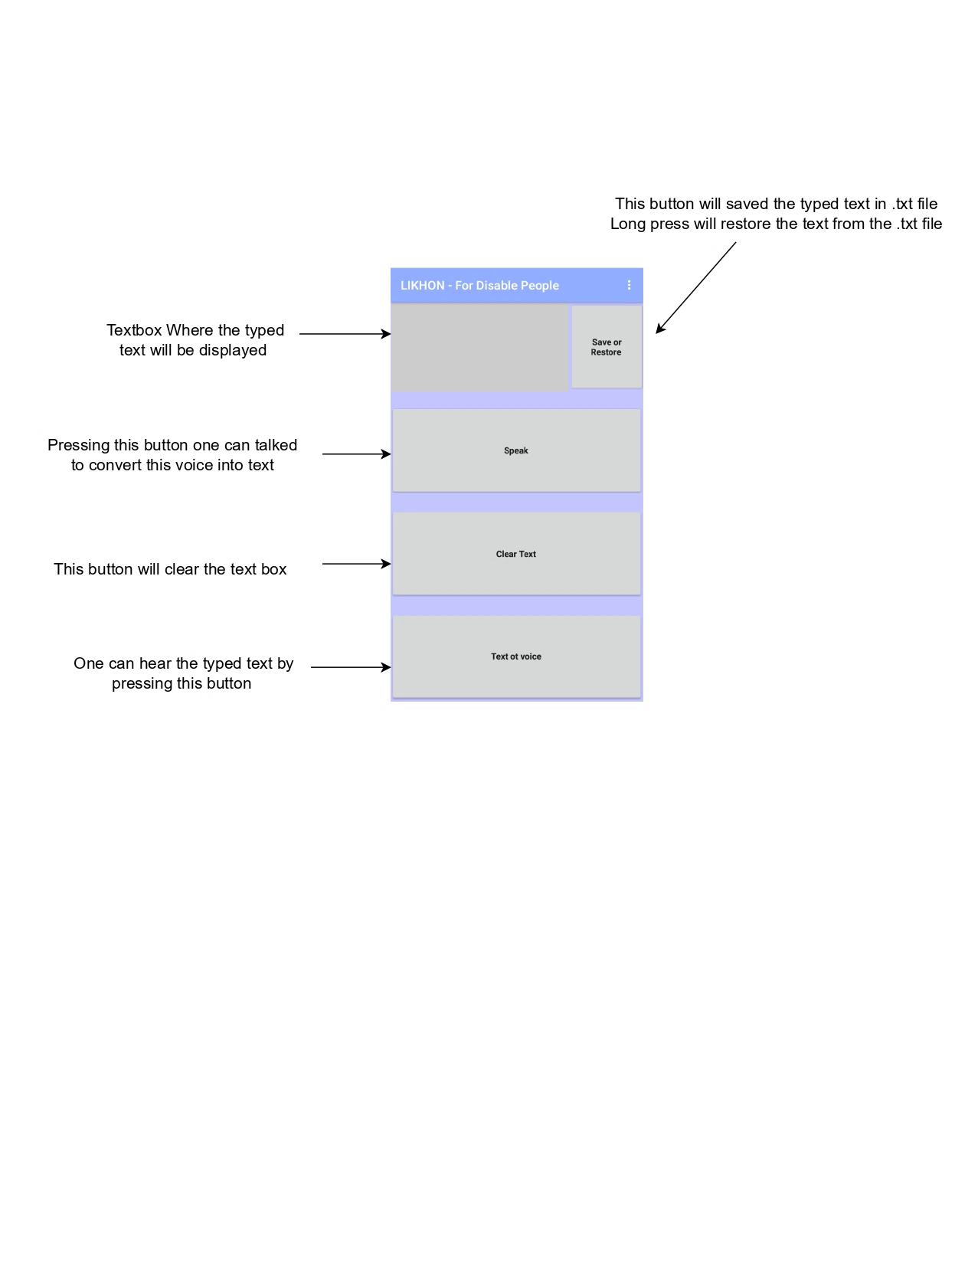
App Interface Design(Cont..)
Typing Interface for Disable People:

Slide 21
Conclusion
Our project successfully demonstrates the conversion of hand gestures into text, providing a valuable communication tool for individuals with speech or hearing impairments.
Our app operates flawlessly with a high level of accuracy.
One potential limitation to consider is the impact of varying lighting conditions on the system's performance.

Slide 22
Recommendations For Future Study
By adding an automatic camera focusing feature can potentially enhance the deep learning accuracy.
Using any updated deep learning models might boost the program’s accuracy and reliability.

Slide 23
References
[1] L. Notarantonio, “Girlfriend slammed for refusing to learn sign language: ‘Selfish,’” Newsweek, Mar. 16, 2023. [Online]. Available: https://www.newsweek.com/reddit-girlfriend-slammed-refusing-learn-sign-languag-1788333
[2] S. R. Kodandaram, N. Kumar, and S. Gl, Sign Language Recognition. 2021.
[3] S. Upendran and A. Thamizharasi, American Sign Language interpreter system for deaf and dumb individuals. 2014, pp. 1477-1481.
[4] M. Panwar, "Hand gesture recognition based on shape parameters," 02/01 2012.
[5] B. Chitradevi, P. S. J. I. J. o. I. R. i. Computer, and C. Engineering, "An Overview on Image Processing Techniques," vol. 2, pp. 6466-6472, 2014.
[6] J. Kuruvilla, D. Sukumaran, A. Sankar, and S. P. Joy, "A review on image processing and image segmentation," in 2016 International Conference on Data Mining and Advanced Computing (SAPIENCE), 2016, pp. 198-203.
[7] R. Suganya, T. J. n. I. C. o. E. Meeradevi., and C. Systems, "Design of a communication aid for physically challenged," pp. 818-822, 2015.
[8] H. Mariappan and V. Gomathi, Real-Time Recognition of Indian Sign Language. 2019, pp. 1-6.
[9] B. Parton, "Sign Language Recognition and Translation: A Multidisciplined Approach From the Field of Artificial Intelligence," Journal of deaf studies and deaf education, vol. 11, pp. 94-101, 02/01 2006.
[10] V[1]V. A. Sujan and M. A. Meggiolaro, “<title>Sign language recognition using competitive learning in the HAVNET neural network</title>,” Applications of Artificial Neural Networks in Image Processing V, Apr. 2000, Published, doi: 10.1117/12.382901

Slide 24
References
[11] S. Malassiotis, N. Aifanti, and M. G. Strintzis, “A gesture recognition system using 3D data,” Proceedings. First International Symposium on 3D Data Processing Visualization and Transmission, Published, doi: 10.1109/tdpvt.2002.1024061.
[12] B. S. Parton, “Sign Language Recognition and Translation: A Multidisciplined Approach From the Field of Artificial Intelligence,” Journal of Deaf Studies and Deaf Education, vol. 11, no. 1, pp. 94–101, Oct. 2005, doi: 10.1093/deafed/enj003.
[13] S. Upendran and A. Thamizharasi, “American Sign Language interpreter system for deaf and dumb individuals,” 2014 International Conference on Control, Instrumentation, Communication and Computational Technologies (ICCICCT), Jul. 2014, Published, doi: 10.1109/iccicct.2014.6993193.
[14] K. K. Dutta, S. K. Raju K., A. Kumar G.S., and S. A. Swamy B., “Double handed Indian Sign Language to speech and text,” 2015 Third International Conference on Image Information Processing (ICIIP), Dec. 2015, Published, doi: 10.1109/iciip.2015.7414799.
[15] A. Abraham and V. Rohini, “Real time conversion of sign language to speech and prediction of gestures using Artificial Neural Network,” Procedia Computer Science, vol. 143, pp. 587–594, 2018, doi: 10.1016/j.procs.2018.10.435.
[16] M. Bilgin and K. Mutludogan, “American Sign Language Character Recognition with Capsule Networks,” 2019 3rd International Symposium on Multidisciplinary Studies and Innovative Technologies (ISMSIT), Oct. 2019, Published, doi: 10.1109/ismsit.2019.8932829.
[17] “Hand landmarks detection guide | MediaPipe | Google for Developers,” Google for Developers. [Online]. Available: https://developers.google.com/mediapipe/solutions/vision/hand_landmarker

Slide 25
Thank You
Questions & Any Suggestions

